Slide 1
Psi Chi and Psychology Club 2014 - 2015

Slide 2
ICE BREAKER!
The task is simple: in eighteen minutes, teams must build the tallest free-standing structure out of 20 sticks of spaghetti, one yard of tape, one yard of string, and one marshmallow. The marshmallow needs to be on top.

Slide 3
Who consistently performs badly?

Slide 4
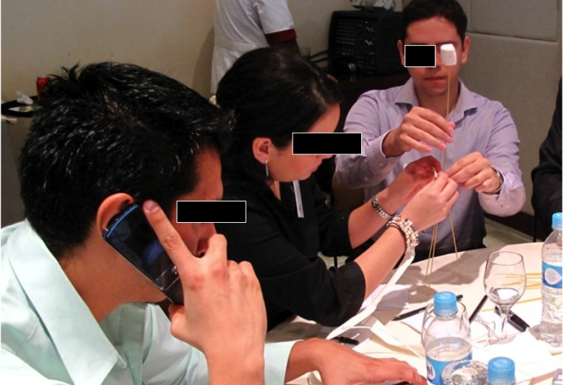
Business School Graduates

Slide 5
Who consistently performs the best?

Slide 6
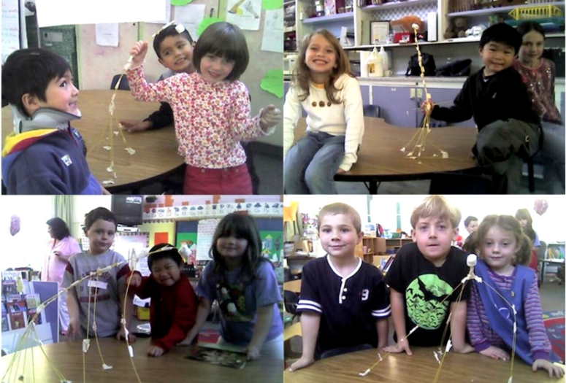
Kindergarten graduates!

Slide 7
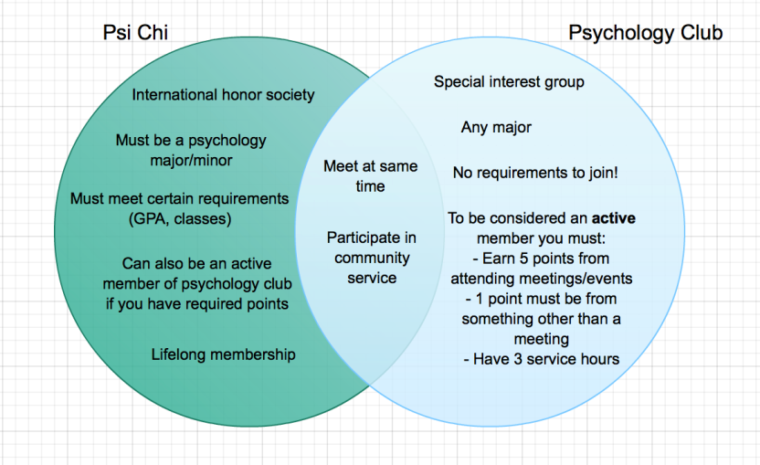
Difference between Psi Chi & Psychology Club

Slide 8
Faculty Advisor: Dr. Earnest
Dr. Earnest is a Professor at Towson University specializing in Industrial and Organizational Psychology. His research interests include recruitment, realistic job previews, human factors and ergonomics, and teams.

Slide 9
Officers
President: Kristen Anzaldi
Vice-President: Kari Haines
Secretary: Kyle Rhodes
Treasurer: Kyle Mondoc
Historian: Gina Binns
Psych Club Rep.: Kimberly Cates
Public Relations: Megan Graffam

Slide 10
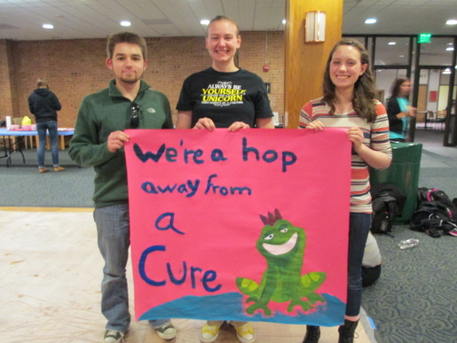
What we do…
Provide research opportunities
Faculty Speakers
Discussion of Hot Topics in Psychology
Career Discussions on the Fields of Psychology
GRE & Graduate School Information
Fun Activities and Events related to Psychology
Community Service

Slide 11
Fall
Semester
Agenda

Slide 12
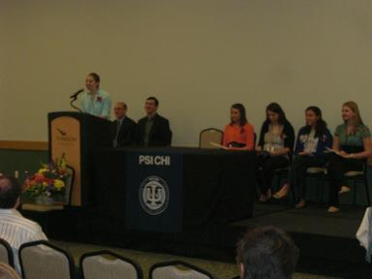
Psi Chi
Requirements:
Major/Minor is Psychology
Completed 3 Semesters of College
Completed at least 9 Semester Hours of Psychology Courses
GPA that is in the top 35% (min. GPA of 3.0 in Psychology Courses)
Benefits:
Grants/Awards
International Recognition
Networking & Experiences
Leadership Development
If you do not meet these requirements you can always be a part of psychology club!

Slide 13
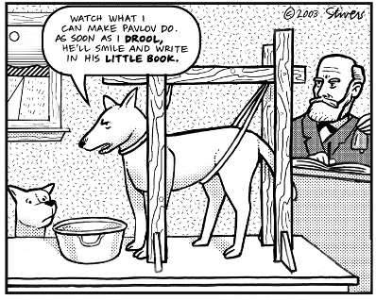
Thank you

