Slide 1
Graduate School Application Process in Psychology
Towson University Career Center

Slide 2
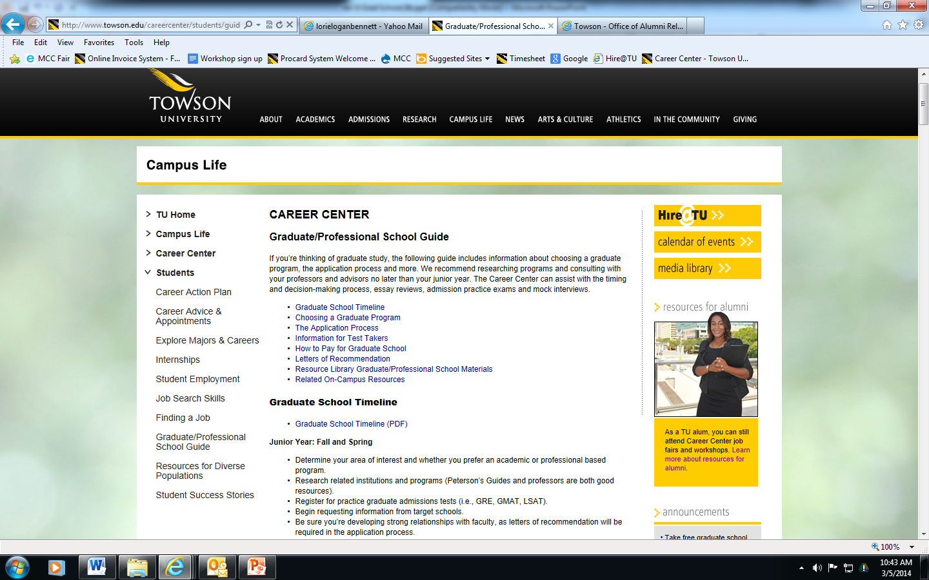
http://www.towson.edu/careercenter/students/guide.asp

Slide 3
How can the Career Center Help with the Grad School Process?
Graduate School Appointment
Resume/ CV Review
Personal Statement Help and Review

Slide 5
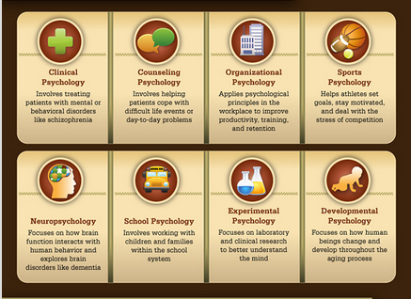

Slide 6
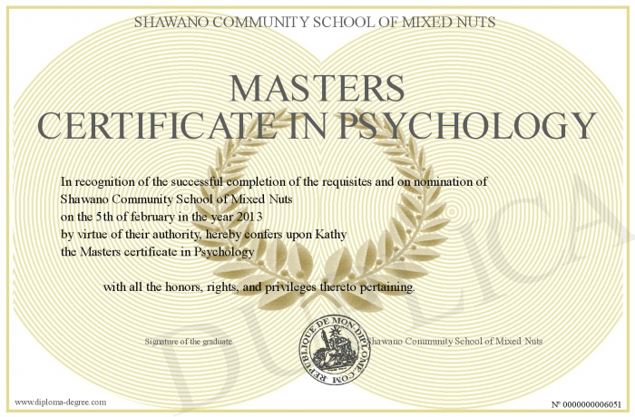
Types of Degrees in Psychology
Masters (M.A. , M.S.)
Generally 2-3 years
More opportunities than bachelor’s degree
Academic or applied tracks
Less financial aid available
Terminal or stepping stone
Part-time or full-time

Slide 7
Doctorate Degrees; PhD versus PsyD
2. PhD (Doctorate of Philosophy)
Generally 5-8 years, dissertation
More opportunities for financial aid
Full-Time
Often required for practicing Psychologists
Emphasis on research
Terminal
3. PsyD (Doctorate of Psychology)
Similar to PhD
Emphasis on practice, not research
Tip: Think about future career goals when considering the different types of programs!

Slide 8
Ultimately, what do you want to do with your degree?
Psy. D. Programs | Ph.D. Programs
Work experience, research experience | Research experience, presentations, publications
Clinically related service | Letters of recommendation
Letters of recommendation | Interview
Interview | Academic Credentials
Academic Credentials

Slide 9
Why Go?
Career in academia
Professional licensing
Career change
Career or salary advancement
Interest in field
Notes:
If doing for career advancement – look at job openings now – how many require an advanced degree (and which ones)

Slide 10
Why Not to Go
Pleasing others
Not sure what to do with undergraduate degree
Not ready for a job
Remember…huge investment in time and money
Go for the RIGHT reasons!

Slide 11
To Go or Not Go: Making a Decision
Talk to as many people as possible
Students in potential program of interest
Professionals in your field of interest (Career Mentor Database, LinkedIn)
Faculty/Advisors
Career Counselors
Employers/Job Announcements
Analyze your needs
Motivations
Strengths and weaknesses
Skills, interests, abilities, values
Limiting factors (time, money, commitments, etc.)

Slide 12
Research: What You Need to Know
Find programs that are:
Strong in your intended field of study
Stable
Involved with/supportive of students
Fit your needs (financial, geographic, etc.) and interests
Admissions requirements (GPA, tests, experience)
Areas of specialization (programs, faculty, etc.)
Program options (thesis –vs- non-thesis)
Applied opportunities (research, internship, practicum)
Reputation of the faculty, program and university
Outcomes: How do graduates do?

Slide 13
How to Pay for Grad School
Teaching Assistantships
Research Assistantships
Graduate Assistantships
Resident Assistantships
Grants/Fellowships
Employer Assistance
Student Loans

Slide 14
Applying
Apply to as many programs as possible
Consider application costs
$50 - $90 application fee
Know where you stand—how you compare to other candidates
Identify safe, middle, and reach schools

Slide 15
Requirements
Admissions requirements typically include the following:
Admissions exam results
Transcripts -- GPA
Personal statement
Letters of recommendation
Financial Aid Application
Know what to send!

Slide 16
Admission Exams
Examples: GRE, MCAT, LSAT, GMAT
GRE more general
Verbal, quantitative, analytical writing
Option of subject tests (psychology, biology)
Computer adaptive, timed
Important for some programs, not for others
Tip: take exam while in college or soon after
Notes:
Tip: take a “test drive” --- practice grad school admission exam co-sponsored by the Career Center and Kaplan

Slide 17
GPA
Most programs expect minimum of 2.7-3.0
Make note of personal problems that affected a specific semester
Focus on junior and senior years
Upper-level courses
More focused study
Higher demands

Slide 18
Personal Statement
Purpose
How you think
How you write
Sell yourself -- Personal + Persuasive
Why should they admit you?
Fill in the blanks
Connect past, present + future
Synthesize - Tie all pieces of your application together
Assess motivation, compatibility/fit
Committees admit people, not credentials!
Notes:
Help from Career Center + Writing Center

Slide 19
Letters of Recommendation
Make it easy for references! Give them…
Instructions, information, and deadlines for each program
Resume and transcripts
Personal statement
Stamped and addressed envelopes for each program
Send reminder emails
Thank you card
Notes:
Follow up! Tell them the results

Slide 20
The Do’s and Don'ts of applying to graduate school
A new qualitative study published in the January issue of Teaching of Psychology (Vol. 15, No. 1) that polled 88 psychology graduate admissions committee chairs to find the mistakes most likely to spell the "kiss of death" to a potential student's application.
Taken from the APA website;
Stambor, Z. (2006, January 1). The don'ts of grad school applications. Retrieved September 26, 2014.

Slide 21
True or False?
Be as open and honest in your application as possible. Committees are looking for information about all parts of yourself, from mental health problems you have overcome to your innate desire to help all people.

Slide 22
FALSE!
Applicants' personal statements should tell admissions committees about their personal and professional background, fit with the program and future career goals. However, admissions committees' chairs disliked applications that include listings of students' own mental health problems, excessively altruistic personal goals, such as "wanting to help all people," or attempts to be "cute" or funny.

Slide 23
True or False?
Not all of your recommendation letters have to be rave reviews. Having some letters that aren’t as favorable as others shows graduate schools all parts of yourself, and gives a more holistic picture of you as a person and student.

Slide 24
FALSE!
Letters of recommendation should elucidate characteristics-such as intelligence, motivation, responsibility and agreeableness-that point toward applicants' ability to excel in graduate school. Too often, admissions committee chairs said, students received unflattering letters because they failed to ask whether the potential recommendation author would write a strongly favorable letter. Respondents also cautioned against letters from inappropriate references, such as people who do not know the applicant well, whose portrayals may not be objective, such as a parent, or who lack an academic context, such as a minister.

Slide 25
True or False?
When applying to a program, don’t attempt to impress them with flattery or prestige. Leaving out praise of the program or name-dropping important people you may know is actually more beneficial than mentioning it.

Slide 26
TRUE!
A number of admissions committee chairs cited a distaste for applications that include insincere flattery, such as praising the program in an obsequious manner. Other chairs added inappropriate name-dropping or blaming others for a poor academic record as potential kisses of death.

Slide 27
Building a Strong Resume; Tip # 1: Assess Your Skills and Experience
Understand your self (motivation, strengths, weaknesses)
Understand your qualifications (skills, interests, experience)
Understand the job market (related industries, sectors)

Slide 28
Tip # 2: Develop a STRONG Resume
Obtain multiple reviews
Talk through your resume with a trained professional
Revise for each job; target skills and experience
Show evidence of abilities more than summary of [unrelated] experience

Slide 29
Tip # 3: Develop Clear, Concise, Easy-to-Read Documents
Select experience and academic projects that reflect your skill and ability
Organize details in a simple format free of distracting background or illustrations
Use enhancements and space effectively
Use conservative, traditional bullets

Slide 30
Tip # 4: Project a Professional Image
List name (avoid nicknames) in larger font size
Use a professional email address (straightforward, name@)
Differentiate (and limit) phone numbers (day/evening, office/cell); check voice messages

Slide 31
Tip # 5: List Education and Related Training
Include institution, degree, major/area of specialization, graduation month/year
Add thesis or project titles/descriptions that relate to targeted job
List additional training, courses or certification that relate to objective
Indicate GPA if above 3.0 (cumulative and/or major) and academic honors

Slide 32
Tip # 6: Target Your Experience
Describe experience and [transferable] skills as they relate to the targeted job
Include job title, name of company and location, dates (month/year) of experience and brief company identification/specialty if not apparent
Emphasize skills you want to use
Quantify/qualify experience; use action verbs and correct verb tenses
List publications and related experience

Slide 33
What’s the difference between a Resume and a CV?
Resume | Curricula Vitae (CV)
Generally 1 page in length | Can be as lengthy as your accomplishments
General, concise introduction of your experiences and skills in relation to a particular position | Fairly detailed overview of your life’s accomplishments, most relevant to realm of academia (“academic resume”)
Includes: Name and Contact Information Education Work Experience | Name and Contact Information Areas of Interest Education Grants, Honors and Awards Publications and Presentations Employment and Experience Professional Memberships References

Slide 34
Sample CV

Slide 35
Visit The Career Center
Career/major counseling
Reviews and critiques (resume, personal statement)
Mock Interviews
410-704-2233
careercenter@towson.edu
www.towson.edu/careercenter
7800 YR, suite 206
Monday-Friday:
8 a.m.-5 p.m.
Express Hours M-TH,1 -4 p.m.
Notes:
Keep eyes out for Career Center grad school related events (Grad School 101 in the fall; personal statement writing workshop; KAPLAN test prep workshops ea. Semester)

